Slide 1
“THEORY OF AUTOMATA”
Pseudo theorem

Slide 2
Summary
Examples of building TG’s corresponding to the Regular Grammar, Null productions with examples, Nullable productions with examples, Unit production with example, Chomsky Normal Form (Definition)

Slide 3

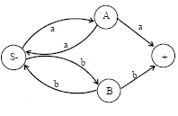
Example
Consider the following CFG
S aA|bB
A aS|a
B bS|b
then the corresponding TG will be
The corresponding RE may be (aa+bb)+.

Slide 4

Example
Consider the following CFG
S aaS|bbS|abX|baX|Λ
X aaX|bbX|abS|baS,
then the corresponding TG will be
The corresponding language is EVEN-EVEN.

Slide 5
Null Production
Definition
The production of the form nonterminal Λ is said to be null production.
Example:
Consider the CFG, S aA|bB|Λ, A aa|Λ, B aS
Here S Λ and A Λ are null productions.
Note
If a CFG has a null production, then it is possible to construct another CFG without null production accepting the same language with the exception of the word Λ i.e. if the language contains the word Λ then the new language cannot have the word Λ.

Slide 6
Method to construct a CFG without null production for a given CFG
Method
Delete all the Null productions and add new productions e.g. consider the productions of a certain CFG X aNbNa, N Λ delete the production N L and using the production X aNbNa, add the new productions X aNba, X abNa and X aba
Thus the new CFG will contain the productions
X aNba|abNa|aba|aNbNa
Note: It is to be noted that X aNbNa will still be included in the new CFG.

Slide 7
Nullable Production
Definition
A production is called nullable production if it is of the form N Λ
Or there is a derivation that starts at N and leads to Λ i.e. N₁ N₂,
N₂ N₃, N₃ N₄, …, N_{n} L, where N, N₁, N₂,
…, N_{n} are non terminals.

Slide 8
Example
Consider the following CFG
S AA|bB, A aa|B, B aS | L
Here S AA and A B are nullable productions, while B Λ is null a production.
Following is an example describing the method to convert the given CFG containing null productions and nullable productions into the one without null productions

Slide 9
Unit production
The productions of the form nonterminal one nonterminal, is called the unit production.
Following is an example showing how to eliminate the unit productions from a given CFG.

Slide 10
Example
Consider the following CFG
S A|bb
A B|b
B S|a
Separate the unit productions from the nonunit productions as shown below
unit prods. nonunit prods.
S A S bb
A B A b
B S B a

Slide 11
S A gives S b (using A b)
S A B gives S a (using B a)
A B gives A a (using B a)
A B S gives A bb (using S bb)
B S gives B bb (using S bb)
B S A gives B b (using A b)
Thus the new CFG will be S a|b|bb, A a|b|bb, B a|b|bb.
Which generates the finite language {a,b,bb}.

Slide 12
Chomsky Normal Form
If a CFG has only productions of the form
nonterminal string of two nonterminals
or
nonterminal one terminal
then the CFG is said to be in Chomsky Normal Form (CNF).
Chomsky Normal Form, Theorem regarding CNF, examples of converting CFG to be in CNF, Example of an FA corresponding to Regular CFG, Left most and Right most derivations, New format of FAs.

Slide 13
Theorem
All NONNULL words of the CFL can be generated by the corresponding CFG which is in CNF i.e. the grammar in CNF will generate the same language except the null string.

Slide 14
Example
Consider the following CFG
S aSa|bSb|a|b|aa|bb
To convert the above CFG to be in CNF, introduce the new productions as
A a, B b, then the new CFG will be
S ASA|BSB|AA|BB|a|b
A a
B b

Slide 15
Introduce nonterminals R1 and R2 so that
S AR1|BR₂|AA|BB|a|b
R₁ SA
R₂ SB
A a
B b
which is in CNF.
It may be observed that the above CFG which is in CNF generates the NONNULLPALINDROME, which does not contain the null string.

Slide 16
Example
To construct an FA that accepts the grammar
S abA
A baB
B aA|bb
The language can be identified by the three words generated as follows
S abA
abbaB (using A baB)
abba bb (using B bb)
S abA
abbaB (using A baB)
abbaaA (using B aA)
abbaabaB (using A baB)
abbaababb (using B bb)

Slide 17
S abA
  abbaB (using A baB)
  abbaaA (using B aA)
  abbaabaB (using A baB)
abbaabaaA (using B aA)
abbaabaabaB (using A baB)
abbaabaababb (using B bb)
which shows that corresponding language has RE abba(aba)*bb.
Thus the FA accepting the given CFG may be

Slide 18
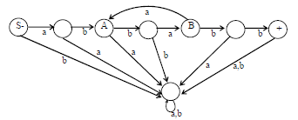

Slide 19
Left most derivation
Definition
The derivation of a word w, generated by a CFG, such that at each step, a production is applied to the left most nonterminal in the working string, is said to be left most derivation.
It is to be noted that the nonterminal that occurs first from the left in the working string, is said to be left most nonterminal.

Slide 20
Theorem
Any word that can be generated by a certain CFG has also a left most derivation.
It is to be noted that the above theorem can be stated for right most derivation as well.

Slide 21
Example
Consider the following CFG
S YX
X XX|b
Y YY|a
Following are the left most and right most derivations of abbbb
S YX
aX
aXX
abX
abXX
abbX
abbXX
abbbX
= abbbb
S YX
YXX
YXb
YXXb
YXbb
YXXbb
YXbbb
Ybbbb
= abbbb

Slide 22
Summary
New format for FAs, input TAPE, START, ACCEPT , REJECT, READ states Examples of New Format of FA, PUSH Down STACK , PUSH and POP, Example of PDA

Slide 23
A new format for FAs
A class of machines (FAs) has been discussed accepting the regular language i.e. corresponding to a regular language there is a machine in this class, accepting that language and corresponding to a machine of this class there is a regular language accepted by this machine. It has also been discussed that there is a CFG corresponding to regular language and CFGs also define some nonregular languages, as well
There is a question whether there is a class of machines accepting the CFLs? The answer is yes. The new machines which are to be defined are more powerful and can be constructed with the help of FAs with new format.

Slide 24

Input TAPE
The part of an FA, where the input string is placed before it is run, is called the input TAPE.
The input TAPE is supposed to accommodate all possible strings. The input TAPE is partitioned with cells, so that each letter of the input string can be placed in each cell. The input string abbaa is shown in the following input TAPE.
The character ∆ indicates a blank in the TAPE. The input string is read from the TAPE starting from the cell (i).
It is assumed that when first ∆ is read, the rest of the TAPE is supposed to be blank.

Slide 25

The START state
This state is like initial state of an FA and is represented by

Slide 26

An ACCEPT state
This state is like a final state of an FA and is expressed by

Slide 27

A REJECT state
This state is like dead-end non final state and is expressed by

Slide 28

A READ state
This state is to read an input letter and lead to some other state. The READ state is expressed by

Slide 29

Example
Before some other states are defined consider the following example of an FA along with its new format

Slide 30
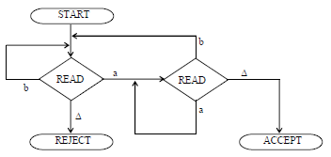
Obviously the above FA accepts the language of strings, expressed by (a+b)*a. Following is the new format of the above FA

Slide 31
PUSHDOWN STACK or PUSHDOWN STORE
PUSHDOWN STACK is a place where the input letters can be placed until these letters are refered again. It can store as many letters as one can in a long column.
Initially the STACK is supposed to be empty i.e. each of its storage location contains a blank.
PUSH
A PUSH operator adds a new letter at the top of STACK, for e.g. if the letters a, b, c and d are pushed to the STACK that was initially blank.

Slide 32

The PUSH state is expressed by

Slide 33

POP and STACK
POP is an operation that takes out a letter from the top of the STACK. The rest of the letters are moved one location up.
POP state is expressed as

Slide 34
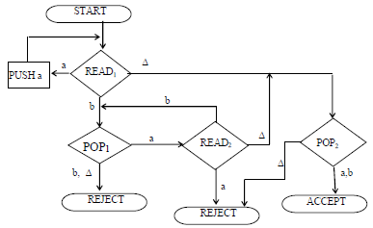
Example
Consider the following PDA

Slide 35
The string aaabbb is to be run on this machine. Before the string is processed, the string is supposed to be placed on the TAPE and the STACK is supposed to be empty as shown below

Slide 36

Reading first a from the TAPE we move from READ1State to PUSH a state, it causes the letter a deleted from the TAPE and added to the top of the STACK, as shown below

Slide 37
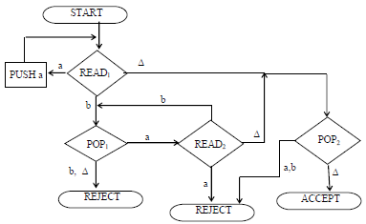
Example of PDA with table for running a string, Equivalent PDA, PDA for EVEN EVEN Language. Non-Derterministic PDA, Example of Non-Derterministic PDA, Definition of PUSH DOWN Automata, Example of Non-Derterministic PDA.

Slide 38
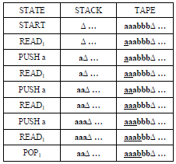
The process of running the string aaabbb can also be expressed in the following table

Slide 39
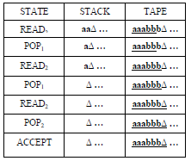
It may be observed that the above PDA accepts the language
{a^{n}b^{n} : n=0,1,2,3, …}.

Slide 40
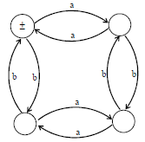
Following is an example of PDA corresponding to an FA
Consider the following FA corresponding to the EVEN-EVEN language

Slide 41
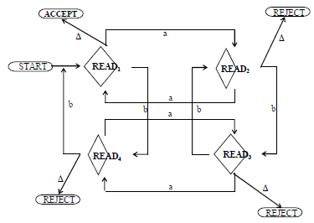
The corresponding PDA will be

Slide 42
Nondeterministic PDA
Like TGs and NFAs, if in a PDA there are more than one outgoing edges at READ or POP states with one label,
then it creates nondeterminism and the PDA is called nondeterministic PDA.
In nondeterministic PDA no edge is labeled by string of terminals or nonterminals, like that can be observed in TGs. Also if there is no edge for any letter to be read from the TAPE, the machine crashes and the string is rejected.
In nondeterministic PDA a string may trace more than one paths. If there exists at least one path traced by a string leading to ACCEPT state, then the string is supposed to be accepted, otherwise rejected.

Slide 43
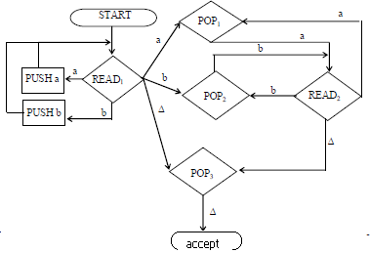
Following is an example of nondeterministic PDA

Slide 44
PUSHDOWN AUTOMATA (PDA)
Pushdown Automaton (PDA), consists of the following
An alphabet S of input letters.
An input TAPE with infinite many locations in one direction. Initially the input string is placed in it starting from first cell, the remaining part of the TAPE is empty. An alphabet G of STACK characters.
A pushdown STACK which is initially empty, with infinite many locations in one direction. Initially the STACK contains blanks.
One START state with only one out-edge and no in-edge. Two halt states i.e. ACCEPT and REJECT states, with in-edges and no out-edges.
A PUSH state that introduces characters onto the top of the STACK.
A POP state that reads the top character of the STACK, (may contain more than one out-edges with same label).
A READ state that reads the next unused letter from the TAPE, (may contain more than one out-edges with same label).

Slide 45
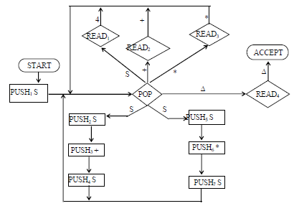
Example
Consider the CFG
S S+S|S*S|4
Following is the PDA accepting the corresponding CFL

Slide 46
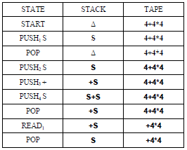
The string 4 + 4 * 4 traces the path shown in the following table

Slide 47
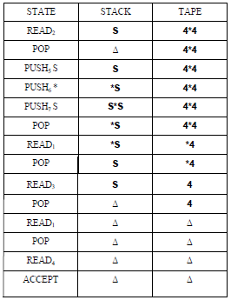

Slide 48
LINK
www.tac.mta.ca/tac/volumes/7/n2/7-02abs.html
linkinghub.elsevier.com/retrieve/pii/S0362546X06004317

